Slide 1
Code 102: Intro to Software Development
Class 08

Slide 2
Agenda
Review of previous class
Share your learning
Computer Logic
Recap: Discussion Reading
Truth Tables
Computer Loops
Demo: `while` and `for`
Lab: Add Features
Notes:
Here’s our plan for class today

Slide 3
Agenda
Review of previous class
Share your learning
Computer Logic
Recap: Discussion Reading
Truth Tables
Computer Loops
Demo: `while` and `for`
Lab: Add Features
Notes:
Here’s our plan for class today

Slide 4
<review>
What did you learn?
Notes:
There are 4 skills in language learning: Hearing, speaking, reading, writing (and we generally develop them in that order).
These review sessions are your chance to SPEAK with this new language. Practice using the right words. Let these foreign sounds emanate from YOUR mouth. The names of these esoteric characters matter, and using the wrong one will make a difference to the computer.
Go around the room. Each student can share a thing learned, or a sentence from their Learning Journal. Help them use the right words. Document the vocab as necessary on the whiteboard.
Ask specifically for what was learned by reading about other student’s learning.

Slide 5
Agenda
Review of previous class
Share your learning
Computer Logic
Recap: Discussion Reading
Computer Loops
Demo: `while` and `for`
Lab: Add Features
Notes:
Here’s our plan for class today

Slide 6
<review>
What did you learn?
Notes:
There are 4 skills in language learning: Hearing, speaking, reading, writing (and we generally develop them in that order).
These review sessions are your chance to SPEAK with this new language. Practice using the right words. Let these foreign sounds emanate from YOUR mouth. The names of these esoteric characters matter, and using the wrong one will make a difference to the computer.
Go around the room. Each student can share a thing learned, or a sentence from their Learning Journal. Help them use the right words. Document the vocab as necessary on the whiteboard.
Ask specifically for what was learned by reading about other student’s learning.

Slide 7
Agenda
Review of previous class
Share your learning
Computer Logic
Recap: Discussion Reading
Computer Loops
Demo: `while` and `for`
Lab: Add Features
Notes:
Here’s our plan for class today

Slide 8
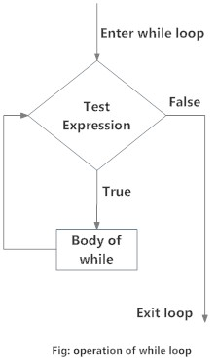
A while Loop
Image: https://www.programiz.com/python-programming/while-loop

Slide 9
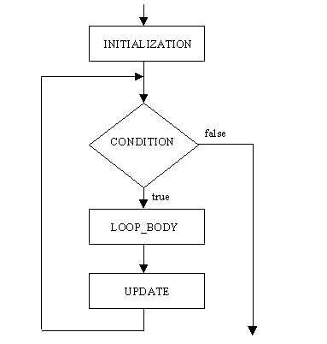
A for Loop
Image: https://clanguageprogrames.blogspot.com/2013/04/syntax-and-flowchart-of-for-loop.html

Slide 10
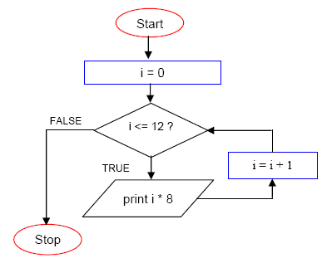
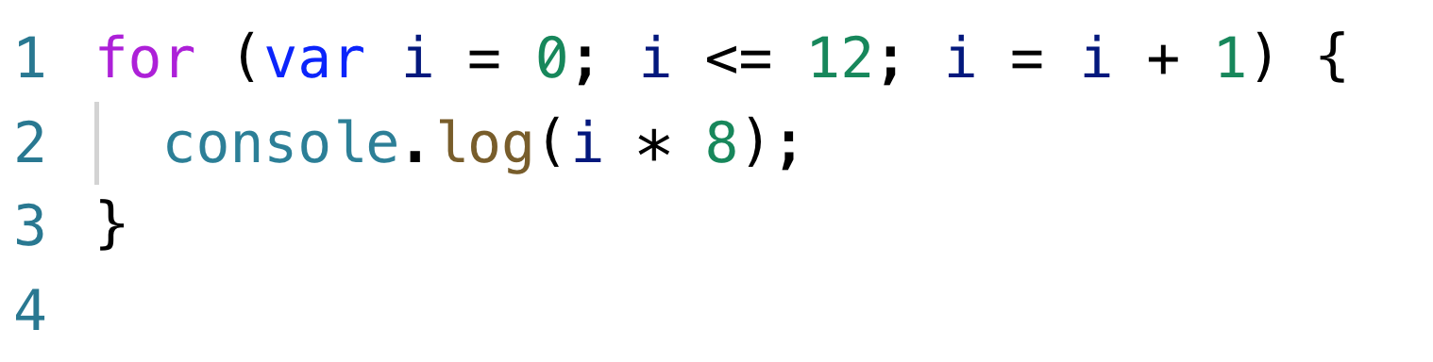
A for Loop
Image: https://www.tenouk.com/clabworksheet/labworksheet7_1.html
Notes:
Let’s change that to code
CRITICAL: Have students walk through the code, and tell you what statements are happening next, what the resulting value is.

Slide 11
<demo>
What can we do with our new skills?
Notes:
Get suggestions on how you want to modify your app with validations and with creating repeated items.

Slide 12
<lab>
Plan it out, then build it out

